Slide 1

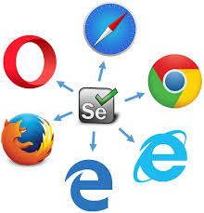
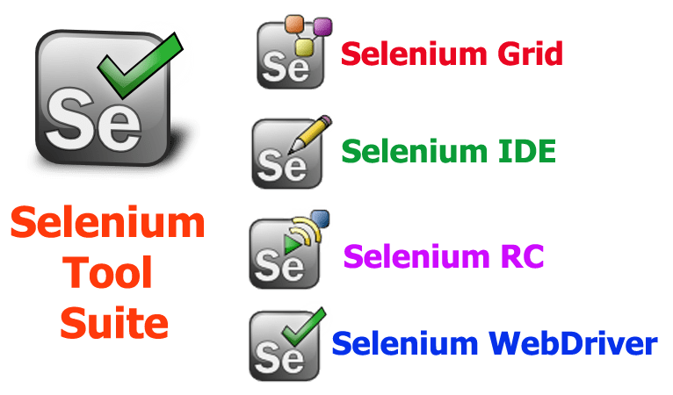
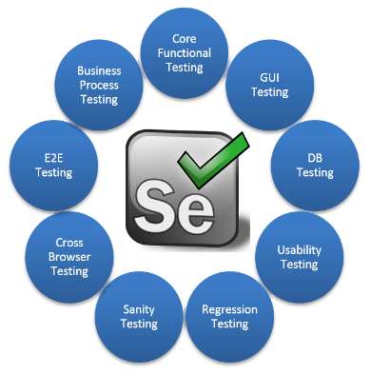
SELENIUM – TEST AUTOMATION TOOL
Software Quality Assurance
HNDIT-4022

Slide 2
CONTENT
Selenium is.
Features of selenium.
Advantages of selenium.
Components of selenium.
References.

Slide 3
1.Selenium is
Open source License.
Browser based web application testing tool
Support for multiple browsers.
Extensible framework.
Selenium Software is not just a single tool but a suite of software.
Support mobile testing (Android,OS)
Write test cases using language of choice java,c#.
Support Native Browser Testing.

Slide 4
2.Features of selenium.
Selenium is functional automation tool for web application.
Selenium is an open source tool.
Selenium supports the language like HTML,Java,PHP,Perl,Python,Ruby, and C#.
It supports the browser like IE,Mozilla Firefox,Safari,Google Chrome and Opera.
It supports the operating systems like Windows,Linux,Mac.
It is very flexible.

Slide 5
3.Advantages of selenium.
Free of cost for company because of open source software.
Customize according to the requirements.
Ajax based system.
Support native testing for all major browsers.
It can be integrated with tools such as TestNG & JUnit for managing test cases and generating reports.
Support for any operating system.

Slide 6
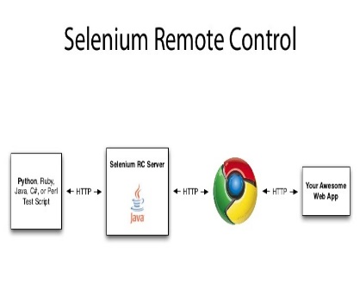



4.Components of selenium
Selenium IDE.
Selenium RC.
Selenium Web Driver.
Selenium Grid.

Slide 7
4.Components of selenium (Cotd.)
1.Selenium IDE.
IDE stand for Integrated Development Environment.
It was a Firefox plugin for faster creation of test cases.
Which is use for Record and Play back the script.
Selenium IDE is a accountable for user action.
We can run the recorded scripts against other browsers by using selenium RC.
Tests recorded via the plugin can be exported in different programming languages like: Java, Ruby, Python etc.

Slide 8
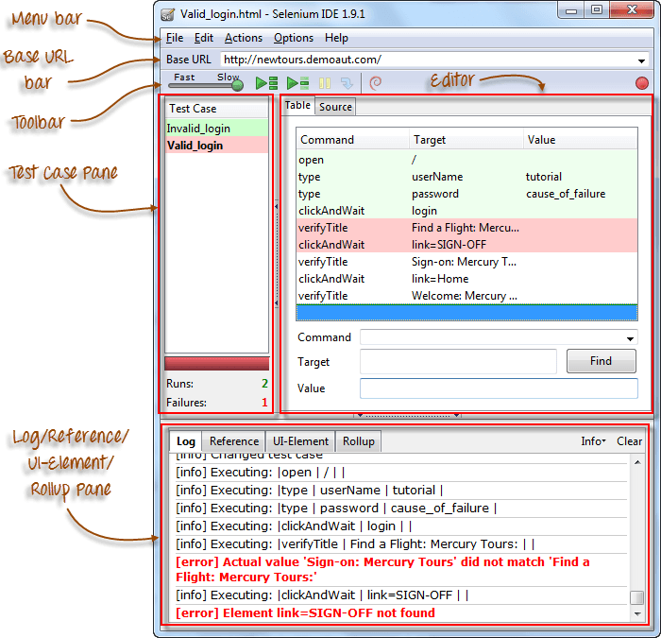
1.Selenium IDE(contd.) - Features

Slide 9
1.Selenium IDE(contd.) – Pros & Cons
Pros
Very easy to use and install.
No programming experience is required, through knowledge of HTML and DOM are needed.
Can export tests to formats unable in Selenium RC and WebDriver.
Has built-in help and test results reporting module.
Provide supports for extensions.
Cons
Available only in Firefox.
Designed only to create prototypes of tests.
No support for iteration and confidential operations.
Test execution is slow compared to that of selenium RC and WebDriver.

Slide 10

Selenium IDE(contd.) – Demo
1.Record and playback selenium
IDE Test Case

Slide 11
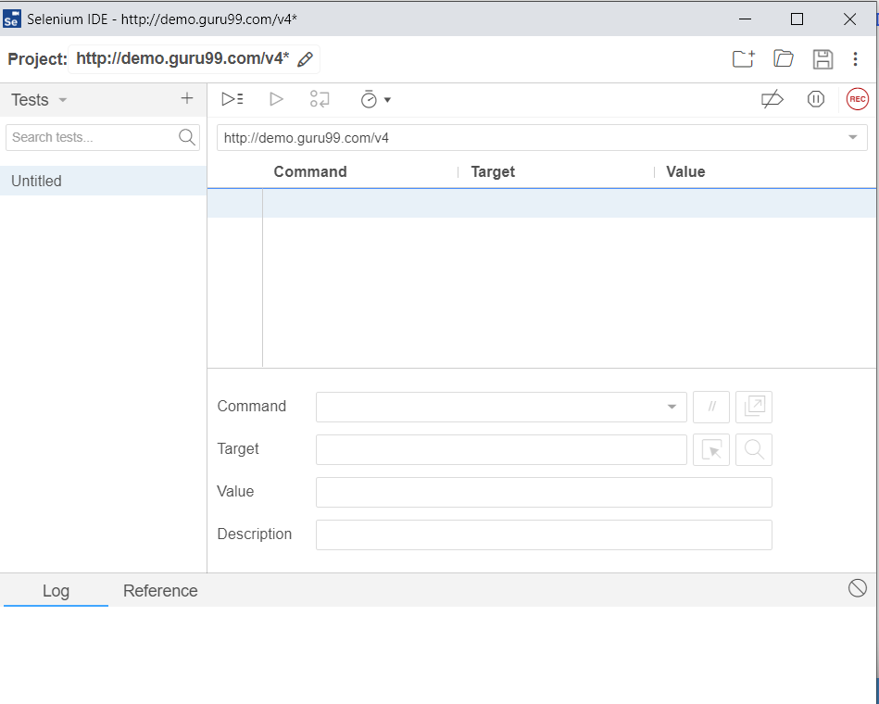
Steps to Record Selenium IDE Test Script
Launch Firefox and Launch Selenium IDE by Clicking on Tools => Selenium IDE.
Type the Base URL value: http://demo.guru99.com/v4
Click on the Record button to start the recording of the Test Case.
Record Button
URL

Slide 12
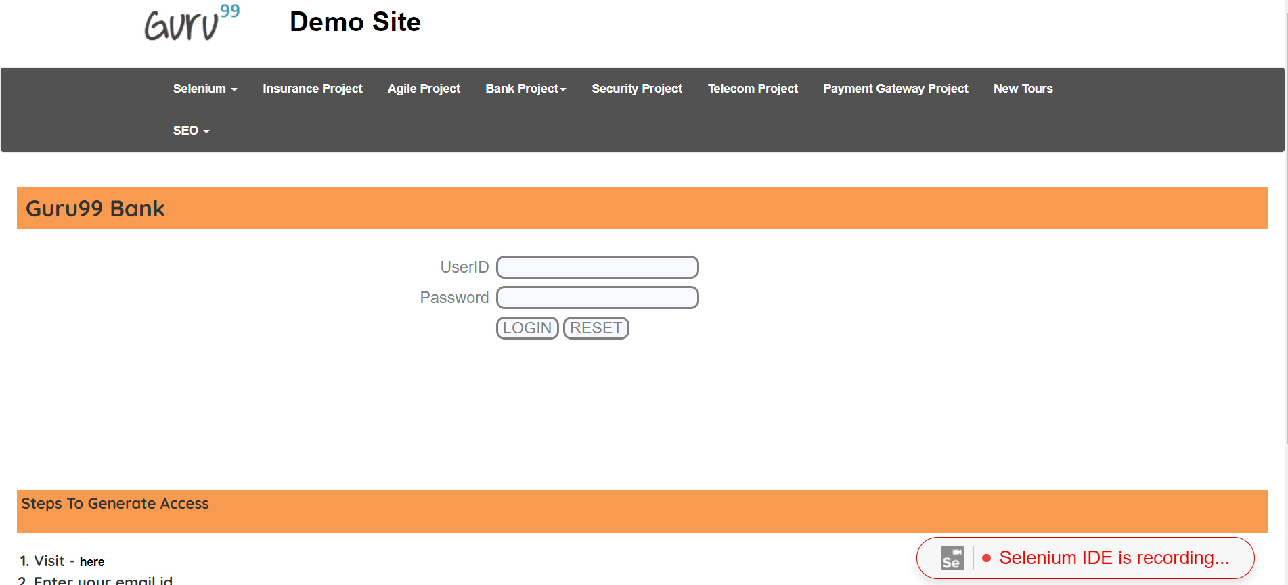
Steps to Record Selenium IDE Test Script (contd.)
4.In Firefox, navigate to http://demo.guru99.com/v4 Firefox should take you to the page similar to the one shown below.

Slide 13
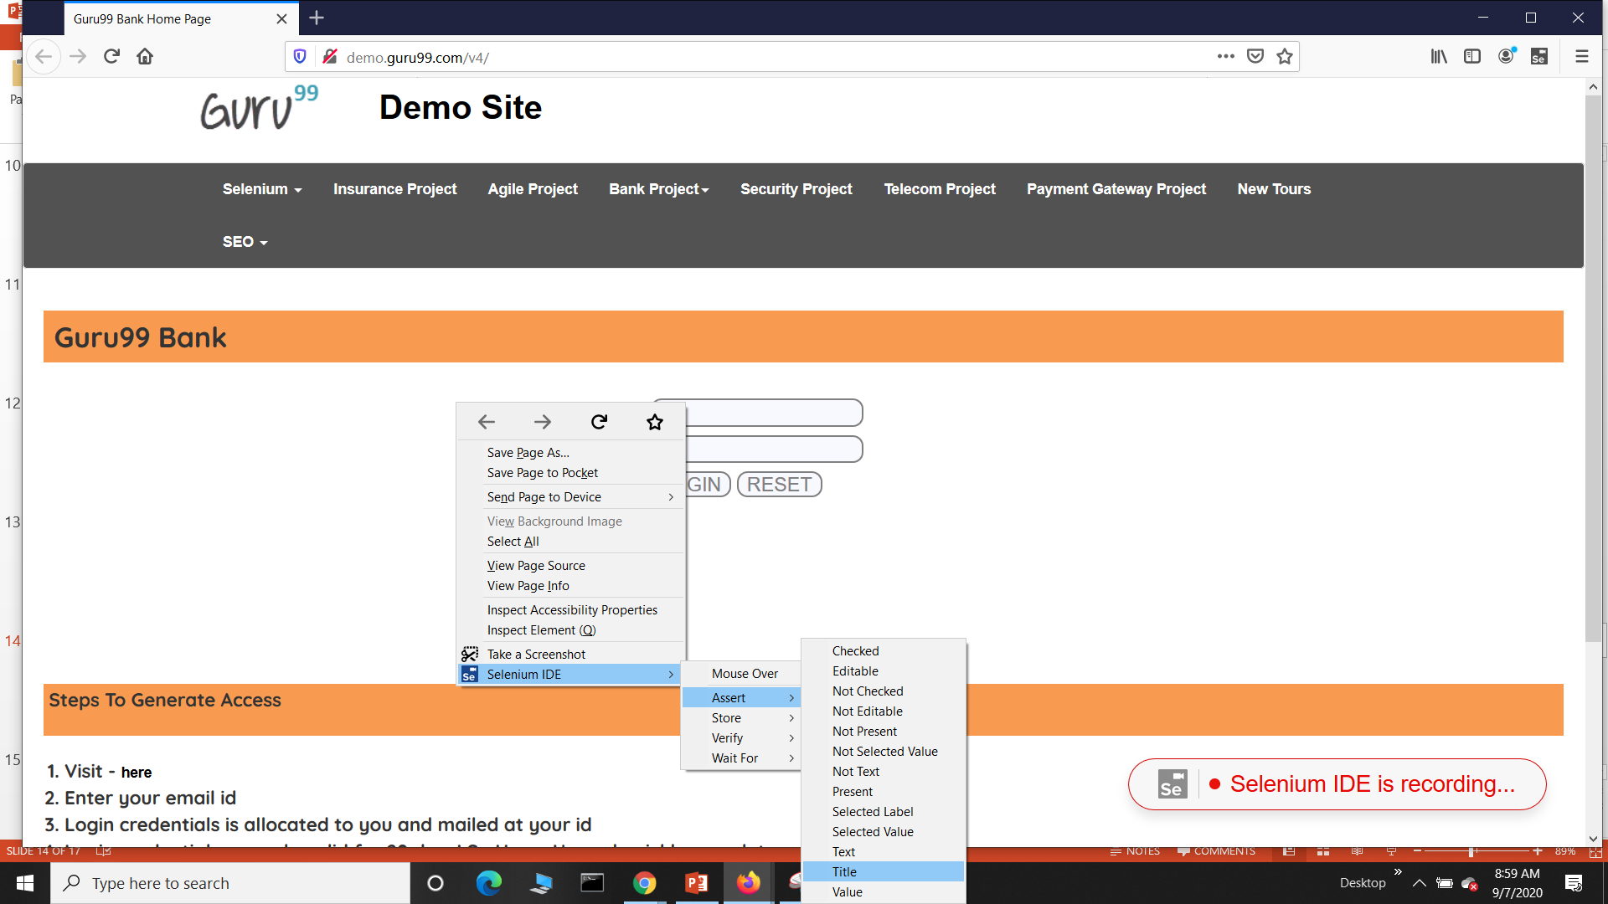
5.Right-click on any blank space within the page, this will bring up the Selenium IDE context menu. Select the Show IDE option. Then, select assert then, select Title This is a command that makes sure that the page title is correct.

Slide 14
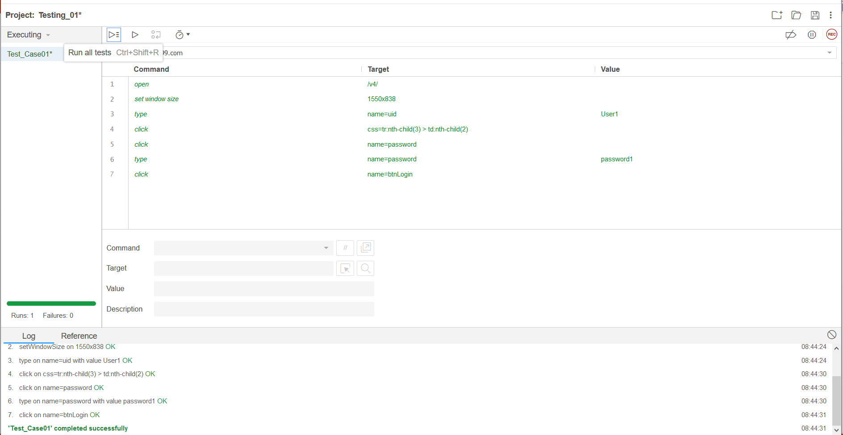
6.Enter Username User1 in the first text box and Password Password1 in the second text box. Then click on Login button to submit.
7. Stop the recording by clicking on the Record button. In the Table tab of Test Step Pane you can see the commands recorded by selenium IDE.

Slide 15
2.Steps to Save Selenium
IDE Test Script

Slide 16
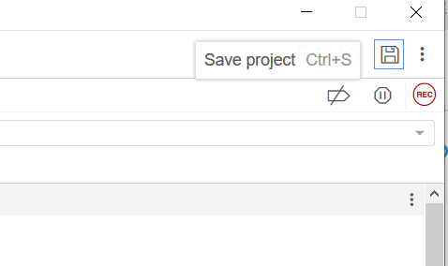
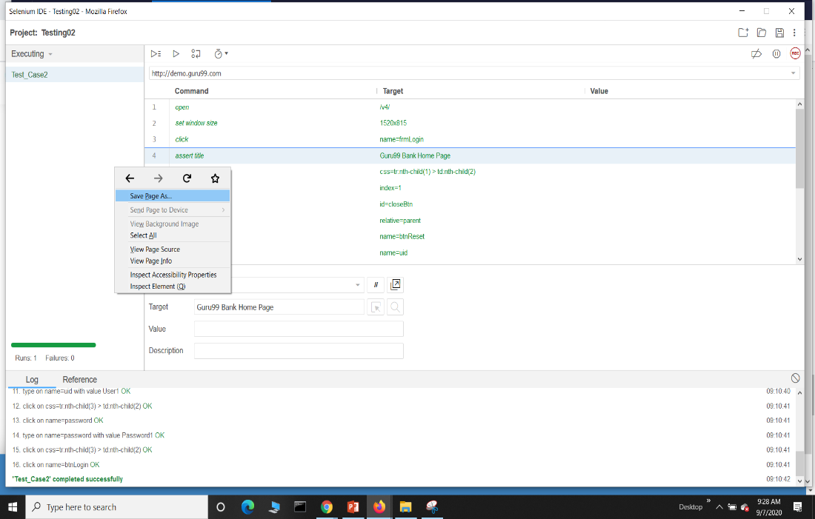
1. Save the test case for future use by clicking on Save project icon or right click and click save as
Save project icon

Slide 17
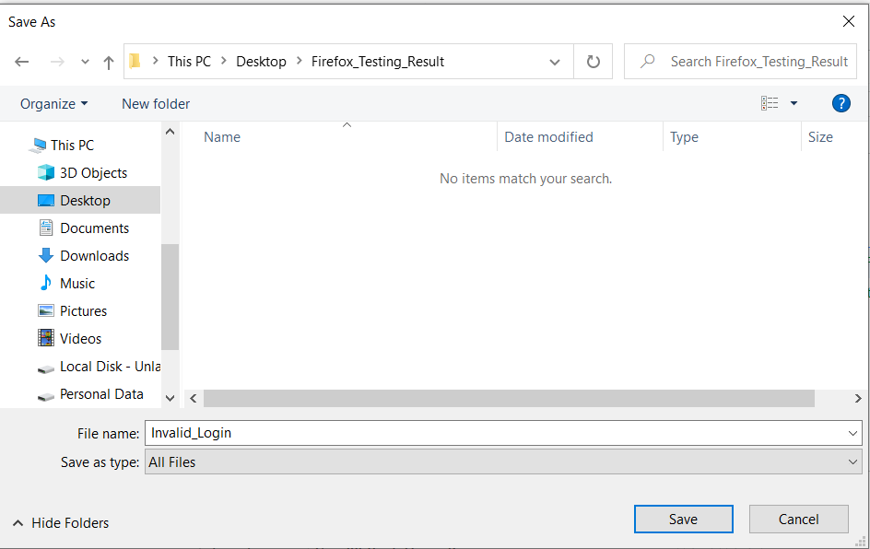
2. Choose your location, and then name the test as Invalid Login. Click the Save button.
Save

Slide 18
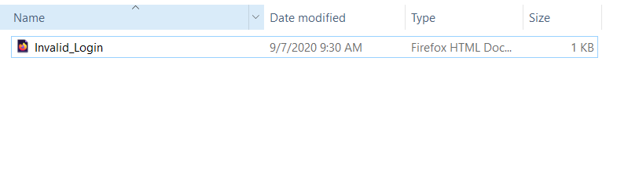
3. The file was saved as HTML.

Slide 19
3.Steps to PlayBack
Selenium IDE Test Script

Slide 20
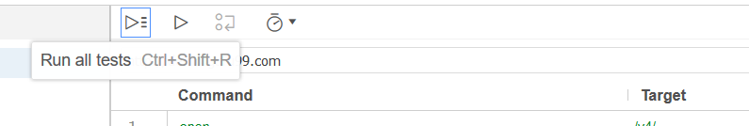
Run all tests

Slide 21
1.Selenium IDE(contd.) - Selenium IDE Commands (Selenese)
1.Actions
Generally manipulate the state of the application.
Eg:-type this box, click this link or select option
If an Action fails current test is stopped.
Many Actions can be called with the AndWait suffix,
e.g. clickAndWait, typeAndWait.
2.Accessors
These commands examine the state of the application and store the result in variables.
Eg:-storeTitle
They are also used to automatically generate Assertions.
3.Assertions
These commands are like accessors, but they verify that the state of the application conforms to what is expected.
Selenium Assertions can also be categorized into three categories.
Eg;-Assert, Verify, WaitFor

Slide 22
1.Selenium IDE(contd.) - Commonly used Selenium IDE commands Additional Reading :- https://ui.vision/rpa/docs/selenium-ide
Command | Description
1.type | Sets the value of an input field, as though you typed it in
2.open | Opens a page using a URL.
3.click | Clicks on a link, button, checkbox or radio button.
4.assertTitle, VerifyTitle | Verifies an expected page title
5. assertElementPresent, verifyElementPresent | Verify / Asserts the presence of an element on a web page.
6. assertTextPresent, verifyTextPresent | Verify / Asserts the presence of a text within the web page.
7.type, typeKeys, sendKeys | Enters a value (String) in the specified web element.

Slide 23
Command | Description
8. Click, clickAt, clickAndWait | Clicks on a specified web element within a web page.
9. waitForPageToLoad | Sleeps the execution and waits until the page is loaded completely.
10. waitForElement Present | Sleeps the execution and waits until the specified element is present
11.chooseOkOnNext Confirmation, chooseCancelOn NextConfirmation | Click on ”OK” or “Cancel” button when next confirmation box appears.
12. highlight | Briefly changes the background Color of the specified element yellow. Useful for debugging.
13. echo | Prints the specified message into the third table cell in your Selenese tables. Useful for debugging.
14.pause | Wait for the specified amount of time (in milliseconds).

Slide 24
1.Selenium IDE(contd.) - Locators
These are the command which are like GUI elements.
Identification of correct GUI elements is a prerequisite to creating an automation script.
But accurate identification of GUI elements is more difficult than it sounds.
Since Selenium provides locators to precisely locate a GUI element.

Slide 25


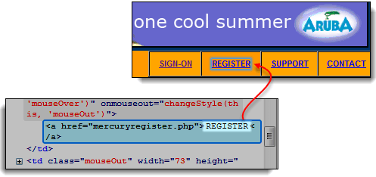
1.Selenium IDE(contd.) - Locators
Locator | Define | Description
1. Locating by ID | id=id of the element | Way of locating elements since ID's
2. Locating by name | name=name of the element | Locating elements by name.
3.Locating by Link Text | link=link_text | This type of locator applies only to hyperlink texts.
4.Locating by CSS Selector | css=tag#id | CSS Selectors are string patterns used to identify an element based on a combination of HTML tag, id, class, and attributes.

Slide 26
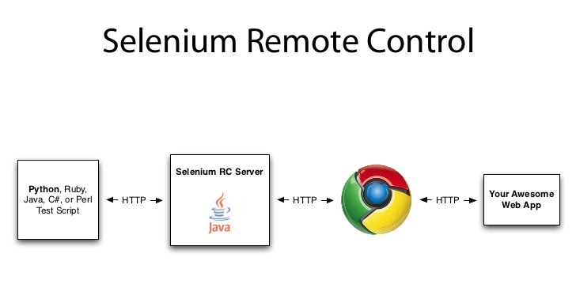
4.Components of selenium (Cotd.)
2.Selenium RC
Flagship Testing Framework of the whole Selenium project for a long time.
Allow users to use a programming language they prefer.
RC version 2.25.0 support for C#,PHP,and Java.
Make request using GET/POST method and capable of setting HTTP requests.
Automate web application.

Slide 27
2.Selenium RC(contd.) – Pros & Cons
Pros
Cross browser and platform.
Can perform looping and conditional operations.
Support for data-driven testing.
Has matured and complete API.
Support for new browsers.
Faster execution when comparing with IDE.
Cons
Installation is not easy when comparing with IDE.
User need technical knowledge regarding programming language.
Need Selenium RC server to execute.
API commands are more confusing.
Less realistic browser interaction.

Slide 28
2.Selenium RC(contd.) – Main components
RC
Server
Client
Library
Selenium
Core
Application Under Test

Slide 29
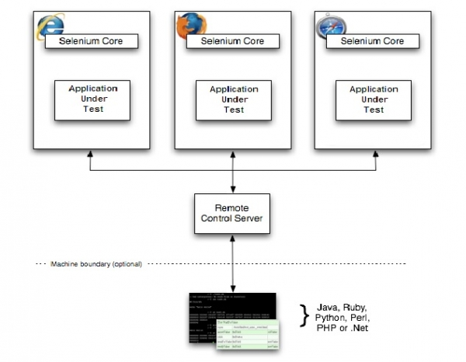
2.Selenium RC(contd.) – Overview of Selenium RC

Slide 30
2.Selenium RC(contd.) – Installation
https://www.protechtraining.com/content/selenium_tutorial-selenium_remote_control

Slide 31
4.Components of selenium (Cotd.)
3.Selenium WebDriver
Better than both Selenium IDE and Selenium RC.
Does not rely on JavaScript for Automation.
It controls the browser by directly communicating with it.
Support language ;- Java, C#, PHP, Python, Perl, Ruby.
It mainly supports browsers like Firefox, Chrome, Safari and Internet Explorer.
You can now use conditional operations like if-then-else or switch-case. You can also perform looping like do-while.

Slide 32
3.Selenium WebDriver(contd.) – Pros & Cons
Pros
Easy to install comparing with RC.
Directly connect with browser.
Support for data-driven testing.
Browser interaction is more realistic.
Execution time is fast than RC and IDE.
Cons
But installation is complicated when comparing with selenium IDE.
Need programming language.
Not support readily for new browsers.
API commands are more confusing.
There was no any built-in mechanism to generate result.

Slide 33
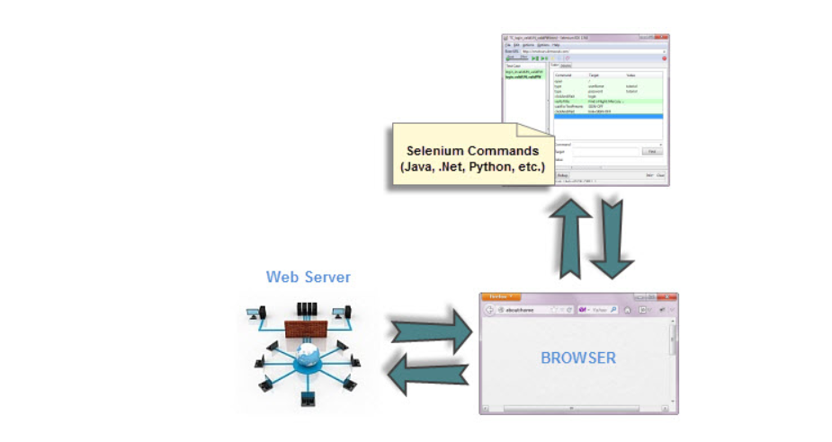
3.Selenium WebDriver(contd.) – Architecture

Slide 34
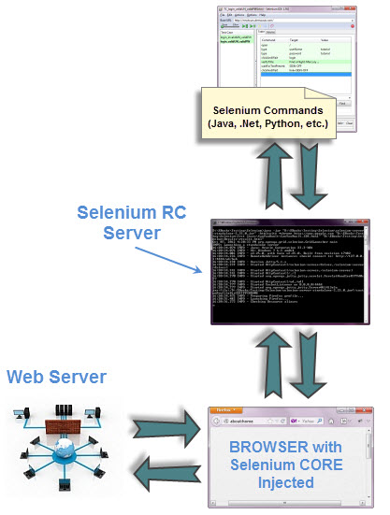
3.Selenium WebDriver(contd.) – Architecture with RC

Slide 35
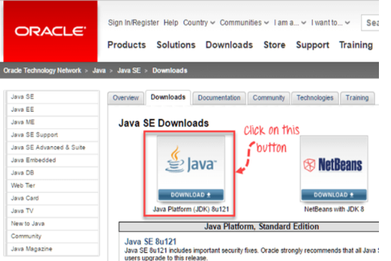
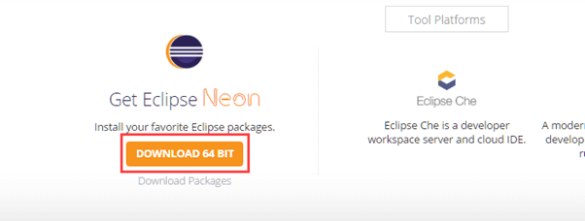
3.Selenium WebDriver(contd.) – Installation
Install Java SDK
Install Eclipse
Install Selenium Driver Files

Slide 36
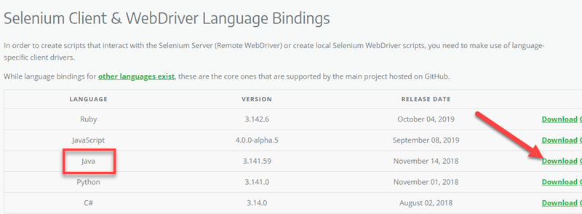
3.Selenium WebDriver(contd.) – Install Selenium Driver Files
Download the Selenium Java Client Driver.
2. Configure Eclipse IDE with WebDriver https://www.guru99.com/installing-selenium-webdriver.html

Slide 37
First Selenium
Web driver Script

Slide 38
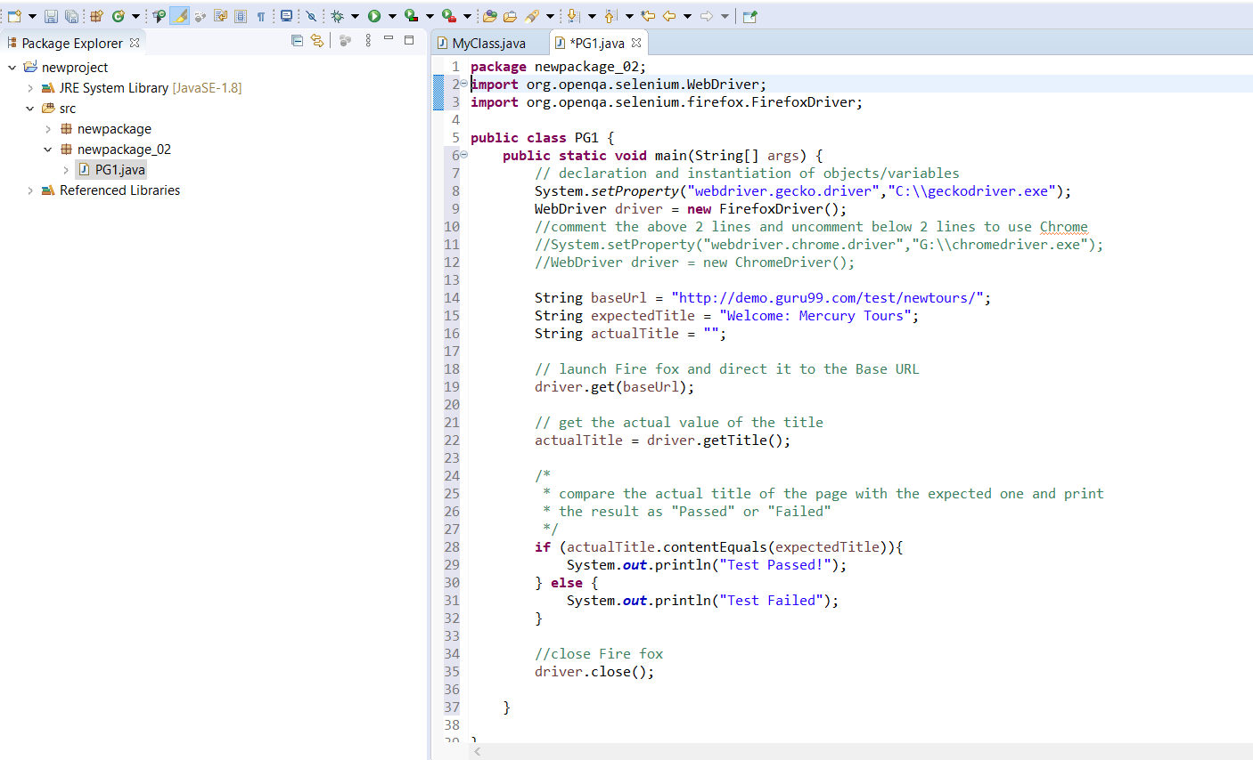
3. First Selenium Web driver Script

Slide 39
1.Instantiating objects and variables The default Firefox profile will be launched by our Java program
2.Launching a Browser Session get() method is used to launch a new browser session and directs it to the URL
3. Get the Actual Page Title getTitle() method that is always used to obtain the page title of the currently loaded page.

Slide 40
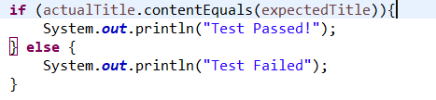

4. Compare the Expected and Actual Values simply uses a basic Java if-else structure to compare the actual title with the expected one..
5. Terminating a Browser Session
simply uses to close the browser window...

Slide 41

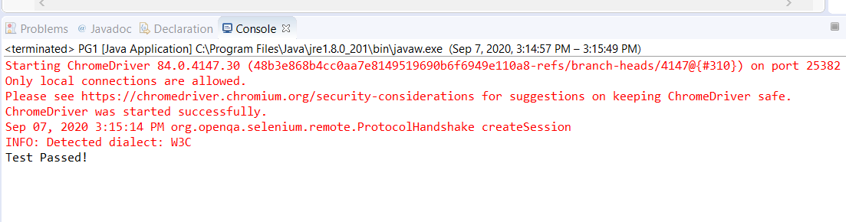
4. Running the Test On Eclipse's menu bar, click Run > Run. Press Ctrl+F11 to run the entire code.
5. Final Result – Console View

Slide 42
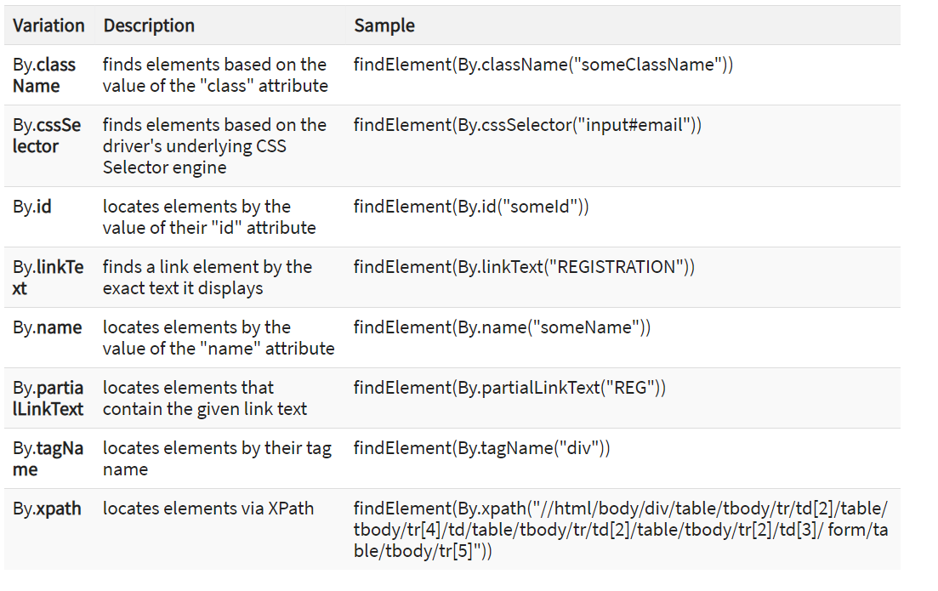
Locating GUI
Elements

Slide 43
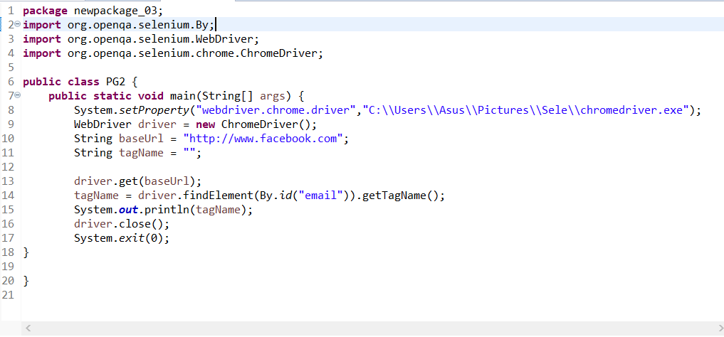

Slide 44
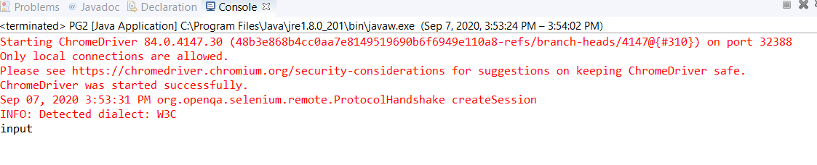
We used the getTagName() method to extract the tag name of that particular element whose id is "email". When run, this code should be able to correctly identify the tag name "input" and will print it out on Eclipse's Console window.

Slide 45
Closing and
Quitting
Browser Windows

Slide 46
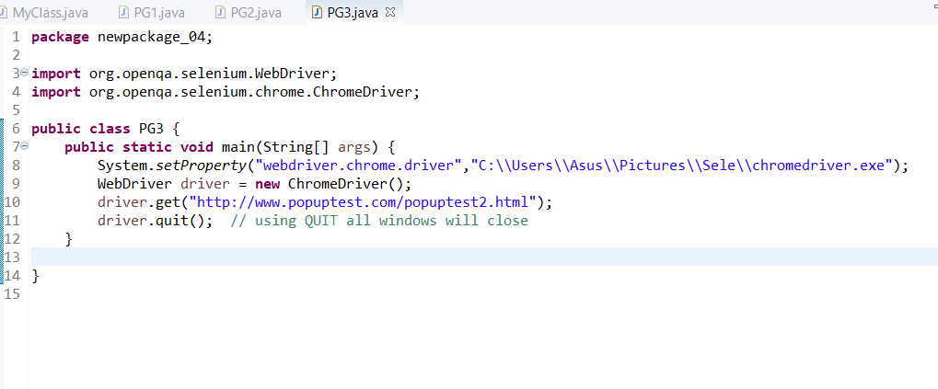
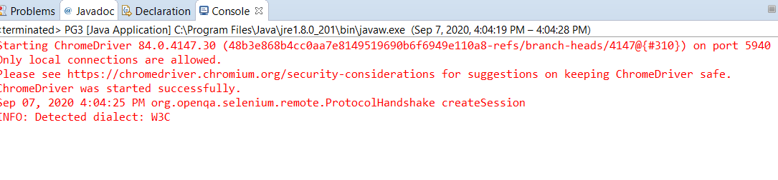
quit(), all windows will be closed - not just the parent one. Try running the code below and you will notice that the two pop-ups above will automatically be closed as well.
that only the parent browser window was closed and not the two pop-up windows.

Slide 47
Switching Between Pop-up Windows

Slide 48
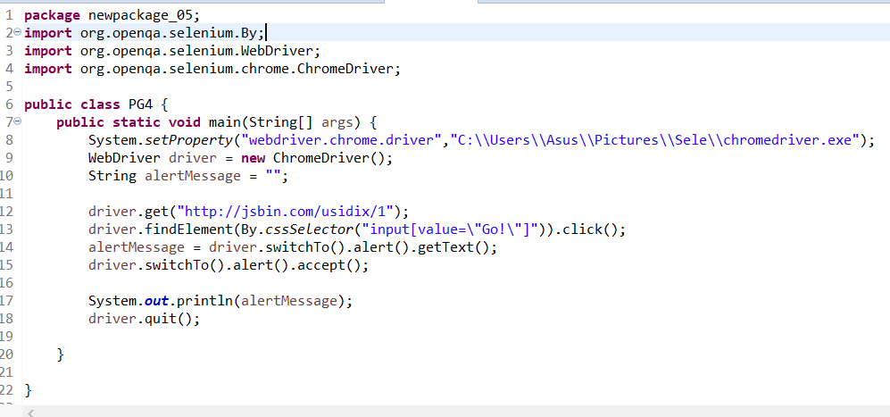
WebDriver allows pop-up windows like alerts to be displayed, unlike in Selenium IDE. To access the elements within the alert (such as the message it contains), we must use the "switchTo().alert()" method.

Slide 49
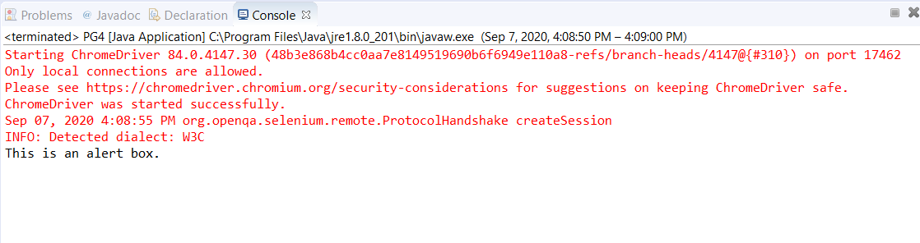
On the Eclipse console, notice that the printed alert message is:

Slide 50
4.Components of selenium (Cotd.)
4.Selenium Grid.
Used together with Selenium RC to run parallel tests (running multiple tests at once)
Across different machines and different browsers all at the same time.
Since Saves time enormously.
Utilizes the hub-and-nodes concept(The hub acts as a central source of Selenium commands to each node connected to it)
To run a huge test suite, that needs to complete in the soonest time possible.

Slide 51
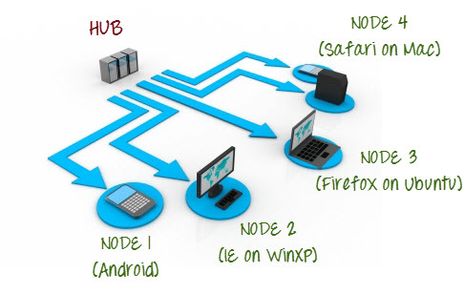
4.Selenium Grid (cotd.) - hub-and-nodes concept
Hub | Node
1.Central point where you load your tests into | 1.Selenium instances that will execute the tests that you loaded on the hub
2. Only be one hub | 2.Can be one or more nodes
3. Launched only on a single machine | 3. Can be launched on multiple machines with different platforms and browsers.
4. The machine containing the hub is where the tests will be run | 4.The machines running the nodes need not be the same platform as that of the hub.

Slide 52
5.References
https://www.guru99.com/introduction-selenuim-ide.html
https://www.guru99.com/first-webdriver-script.html
https://www.guru99.com/introduction-to-selenium-grid.html#:~:text=Selenium%20Grid%20is%20a%20part,server%20acts%20as%20a%20hub.
https://www.edureka.co/blog/what-is-selenium/
https://www.toolsqa.com/selenium-ide/locators-in-selenium-ide/

